Slide 1
Pollination

Slide 2
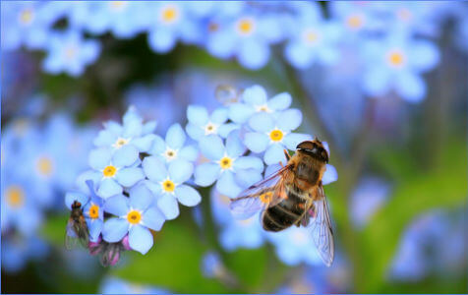
By the end of this Smart Lesson you should be able to:
1. | Explain what pollination is.
2. | State the 4 different methods of pollination.

Slide 3
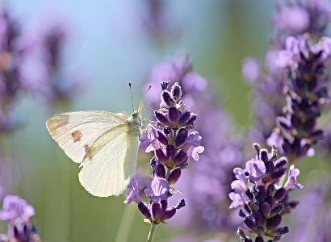
There are four different methods of pollination we will learn about in this Smart Lesson.
1. | Wind pollination
2. | Self pollination
3. | Insect pollination
4. | Cross pollination

Slide 4
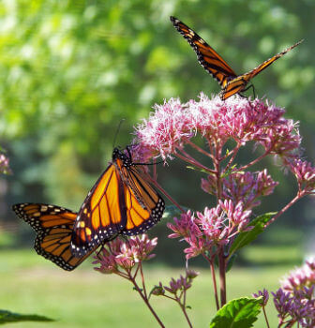
What is Pollination?
Pollination is the process by which pollen is transferred from the anther (male part) to the stigma (female part) of the same or different flower.

Slide 5
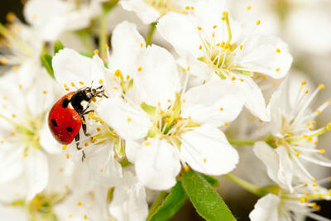
Animals that carry pollen
Animals such as birds, insects and even small mammals can carry pollen between plants.

Slide 6
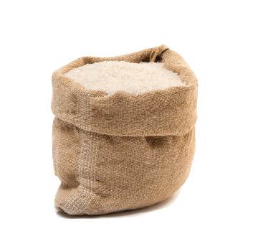
Wind Pollination
Wind-pollinating plants rely on the presence of wind for fertilisation.
Many of the world's most important crop plants are wind-pollinated. These include wheat, rice, corn, rye, barley, and oats.

Slide 7
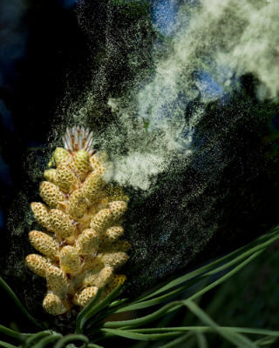
Features of wind pollinated flowers:
1. | Small petals, often dull green or brown as they have no need to attract insects.
2. | Flowers have no scent or nectar as they have no need to attract insects.
3. | Flowers produce large amounts of pollen as it increases the chance that some pollen is transferred to another flower.

Slide 8
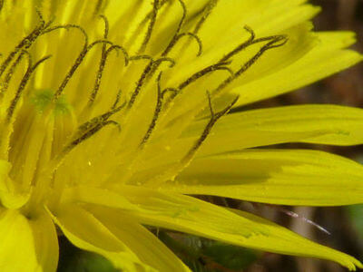
Self Pollination
Self pollination is the transfer of pollen grains from the anther to the stigma of the same flower.

Slide 9
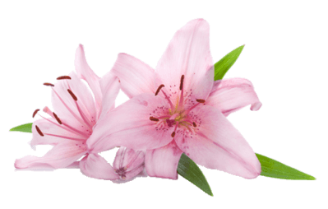
Self pollination produces similar offspring.
This makes a plant less resistant as a whole to disease because there is little variation in the species which means they can adapt very little to changing environmental conditions.

Slide 10
Advantage of Self Pollination
An advantage of self pollinating plants, is that they do not need to expend energy on attracting pollinators and can spread beyond areas where suitable pollinators can be found.

Slide 11
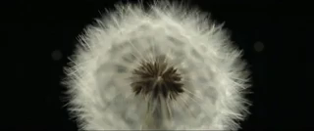
Next time you go out for a walk, take a look around you and think about the different ways thats flowers get pollinated.
The dandelion is a fascinating example. They are capable of both self-pollination and cross-pollination. Feathery seeds are produced to be dispersed by wind. You often see these floating around on a summers day.

Slide 12
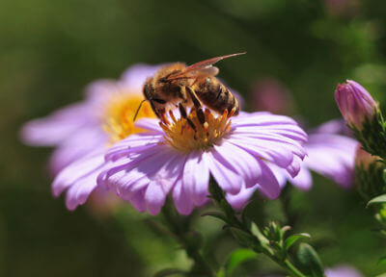
Insect Pollination
Insects can also pollinate flowers.
Insect-pollinated flowers are different in structure from wind-pollinated flowers.

Slide 13
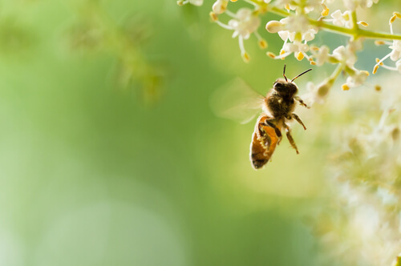
Features of insect pollinated flowers:
1. | Large brightly coloured petals to attract insects.
2. | Usually scented and with nectar to attract insects.
3. | A moderate amount of pollen grains produced because insects transfer pollen efficiently.

Slide 14
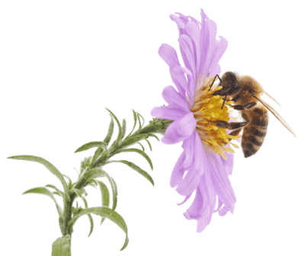
Nectar
Plants have evolved to make nectar to attract the animals.
Nectar is a rich, sugary liquid formed by glands called nectaries at the base of flower petals. The plant may also advertise with brightly coloured petals and sweet perfumes to attract the animals' attention.

Slide 15
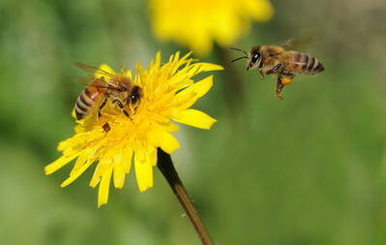
Pollen is transferred from one flower to another as the animals eat the nectar from flowers.
Animals eat the nectar to provide them with energy.
As the animal enters the flower it brushes past the anthers, causing the pollen from which to stick to the animal. After it has fed on one flower the animal moves to another, where the pollen it has taken with it comes off onto the sticky stigma.

Slide 16
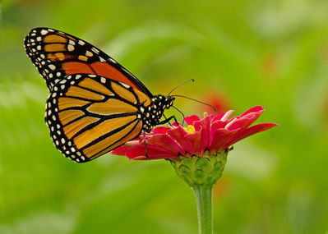
Cross Pollination
Cross pollination is the transfer of pollen from the anther of a flower on one plant to the stigma of a flower on another plant of the same species.

Slide 17
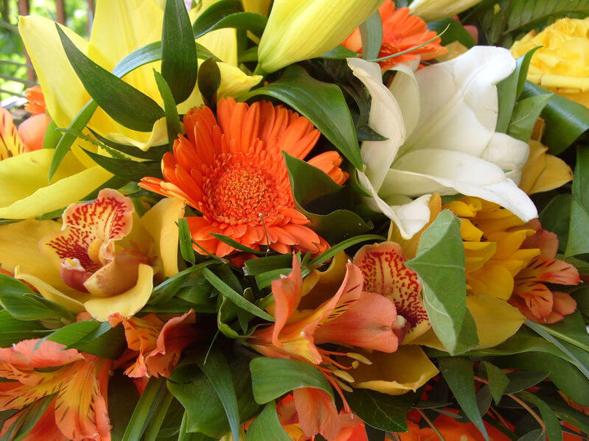
Advantage of Cross Pollination
Cross pollination results in more variety in a species.
It allows for diversity in the species, as the genetic information of different plants are combined. However, this type of pollination completely relies on the existence of pollinators, wind, or water to transfer pollen from plant to plant.

Slide 18
Different animals prefer different types of flowers.
Different birds or insects prefer different types of flowers. For examples, butterflies prefer bright red flowers whereas beetles prefer large, dull, bowl-like flowers.

Slide 19
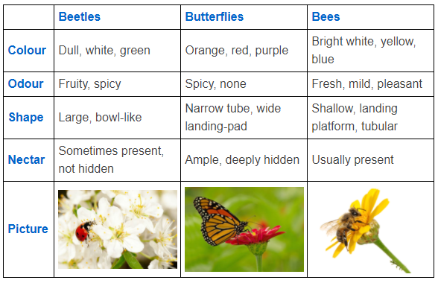
Pollination Table

Slide 20
